Slide 1
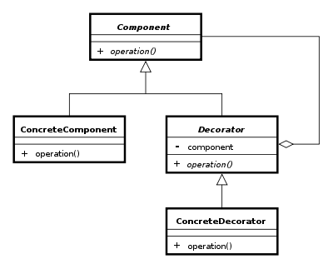
The Decorator pattern
Group 4 Asger Breinholm, Mathias Brændgaard and Robin Bertojo

Slide 2
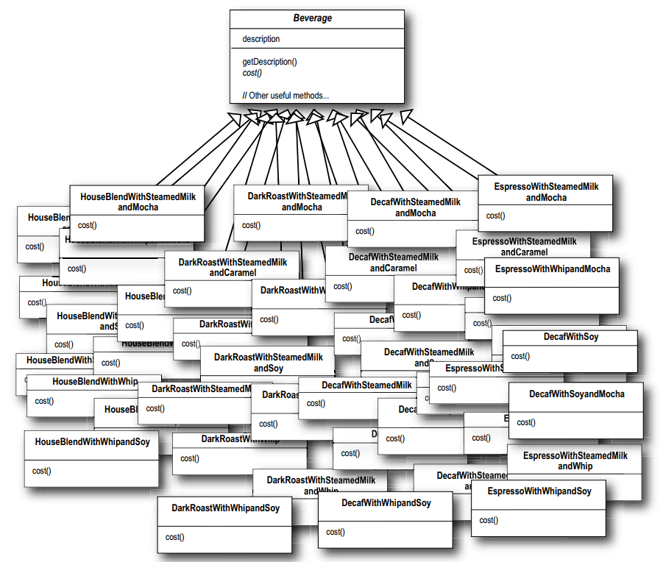

The problem
Subclass everything
class DarkRoastWithMilkAndSugar{
return GetDescribtion;
}
class EspressoWithSugar{
return GetDescribtion;
}
* Head First, Design Patterns – Eric Freeman and Elisabeth Freeman with Kathy Sierra and Bert Bates

Slide 3

The solution – with Decorator
Extension at runtime
class DarkRoast{
GetDescribtion() => ”Dark Roast”;
}
class Milk : DarkRoast{
GetDescribtion() => base. GetDescribtion() + ” with milk;
}
class Sugar : DarkRoast{
GetDescribtion() => base. GetDescribtion() + ” with sugar”;
}
Sugar. GetDescribtion(Milk. GetDescribtion ())
= ”Dark Roast” + ” with milk” + ” with sugar” = ”Dark Roast with milk with sugar”
Saves you from writing a lot of code

Slide 4
Pros & cons
Pros:
Less subclasses
Less memory usage
Add at run time
Any number
Any order
Cons:
More complex undo
More unnecessary code
Can impact execution time

Slide 5
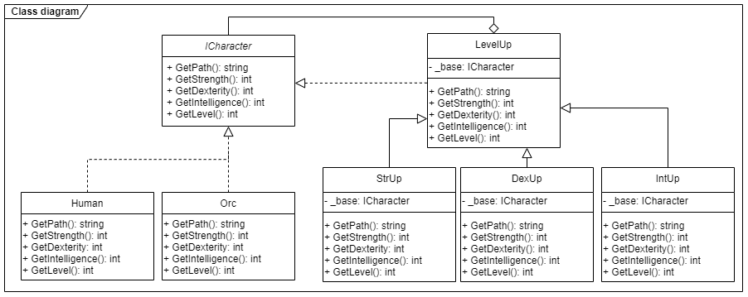
Class diagram

Slide 6
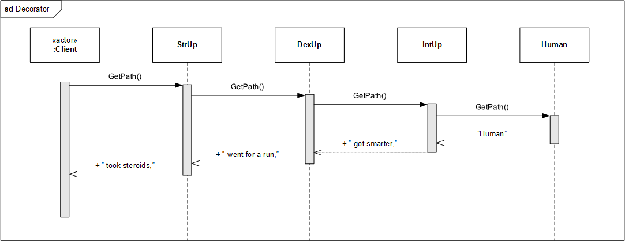
Sequence diagram

Slide 7
Our implementation
LevelUp base:
The decorator StrUp who inherits:

Slide 8
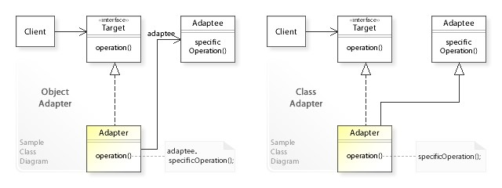
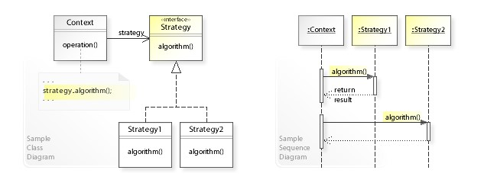
Comparison
Adaptor
Strategy

Slide 9
Conclusion

